Slide 1

Heterogeneous Swarms Motion Planning
Nichols Crawford Taylor, Ryan Davis, Will Graham, Luke McDivitt
University of Utah, Salt Lake City, UT
OTST’ 2011 Santa Barbara

Slide 2

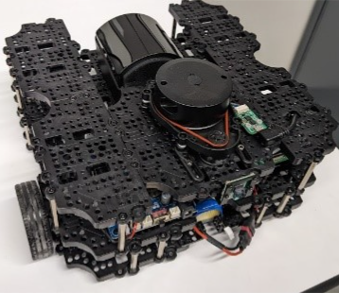
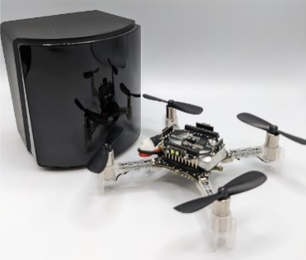
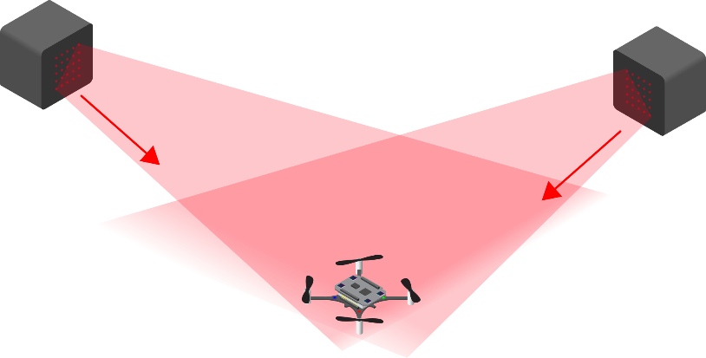
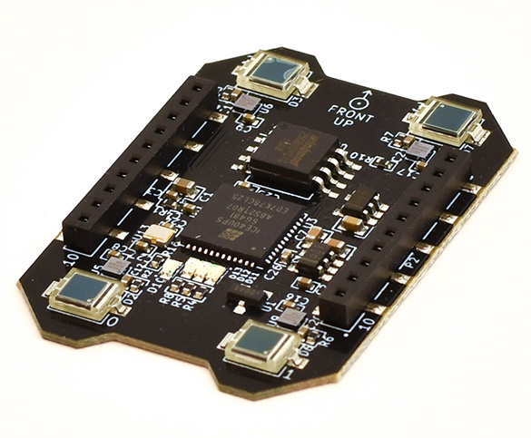
Solution Description
We will create a flexible platform which can be used as a base-station for swarm and multi-robot research
We'll use turtlebots equipped with lighthouse motion capture as mobile "ground-truths", to control a swarm of crazyflies
We are currently working on the hardware end of this, but we were able to have some luck in simulation with both mapping and algorithms to keep turtlebots beneath the crazyflie
Turtlebot equipped with lighthouse basestation (Luke takes great pictures)
Lighthouse deck
Crazyflie and Lighthouse basestation (again, Luke took a great picture)
Default lighthouse basestation and lighthouse deck setup

Slide 3
Solution Description
We will create a flexible platform which can be used as a base-station for swarm and multi-robot research
We'll use turtlebots equipped with lighthouse motion capture as mobile "ground-truths", to control a swarm of crazyflies
We are currently working on the hardware end of this, but we were able to have some luck in simulation with both mapping and algorithms to keep turtlebots beneath the crazyflie
Turtlebot equipped with lighthouse basestation (Luke takes great pictures)
Lighthouse deck
Crazyflie and Lighthouse basestation (again, Luke took a great picture)
Default lighthouse basestation and lighthouse deck setup

Slide 4
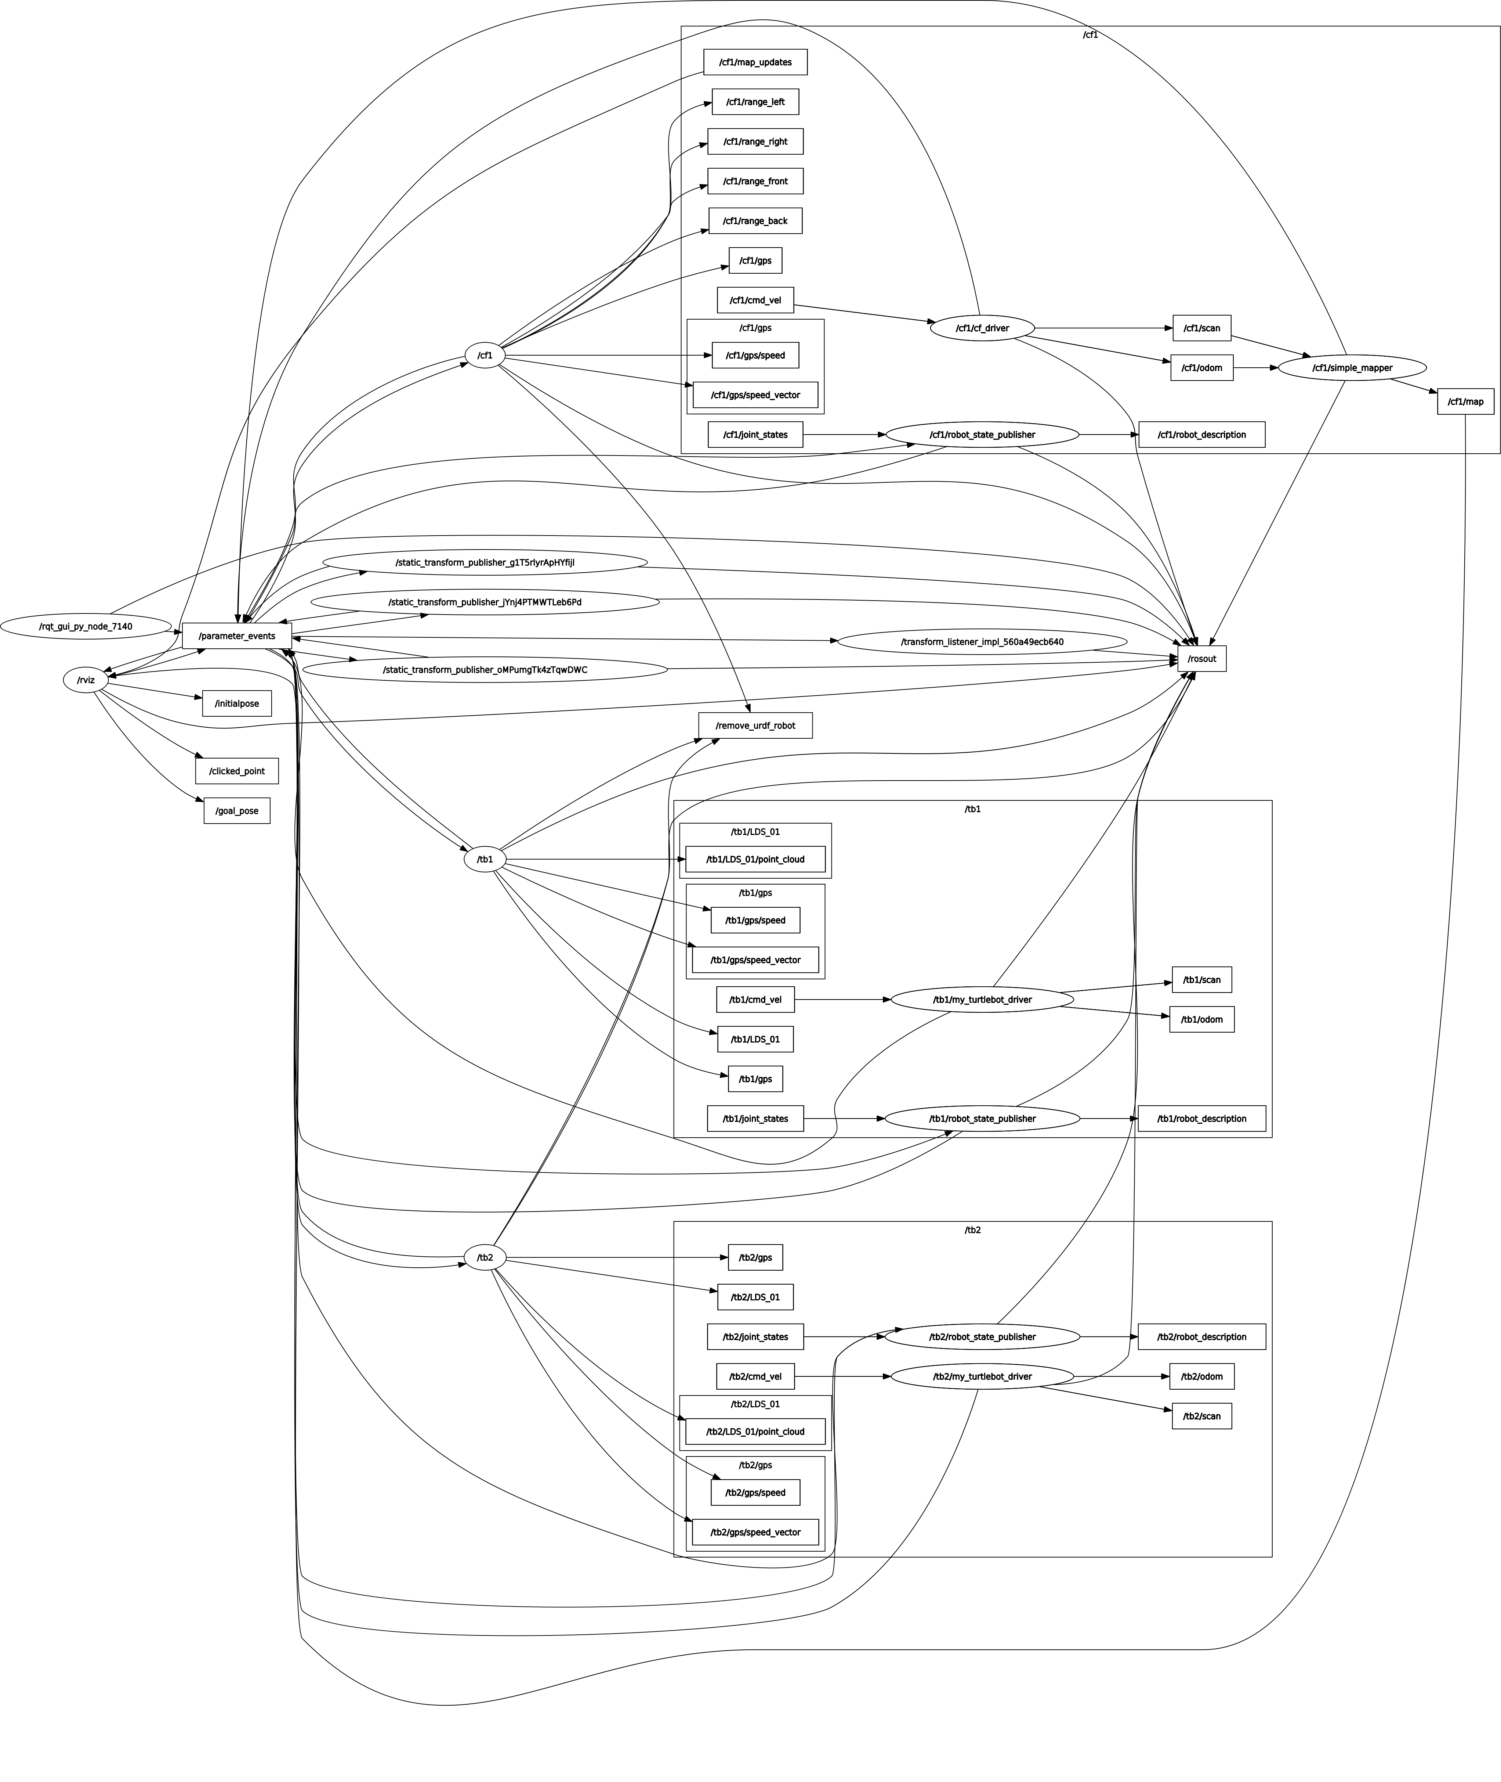
Challenges
ROS2 and WeBots interfacing
URDF->plugin->custom driver->
Namespacing multiple robots
Running multiple extern controllers took us about half the time
Ros2_control doesn't support multiple robots with the same configuration (no multi-robot systems)
Example turtlebot ran on ros2_control, which meant we needed to rewrite a turtlebot driver interacting between ROS2 and WeBots
Nav2 was difficult to make work
Transformations between different ROS2 maps
Writing a mapping interface
Stability of trajectory tracking
Learning ROS2

